Slide 1

Smart House-
A Context Sensitive Multi-Agent System
Technical University of Cluj-Napoca,
Automation and Computer Science Faculty,
Computer Science Department
Coordinator: Asist.Ing. Lucia VĂCARIU
Student: Amalia HOSZU

Slide 2


Presentation Overview
Introduction
Smart House Technologies
Challenges
Context Model Design
Smart House Application
  Ontologic Model
  Agent technologies
  System Design &Architecture
  Results
  Conclusions and Future Work

Slide 3

Introduction
  Context
    context is any information that can be used to characterize the situation of an entity.
  Context Types
  Context Awareness
    how devices can infer and understand the current context based on the input given by the sensors
  Ubiquitous Computing

Slide 4
Challenges
  Detecting context from noisy and often ambiguous sensor data.
  Complexity of capturing, representing and processing contextual data
  Abstract high level data representations from low level data acquired from the sensors
  Detect changes in real time and adapt to constant changes
  Understanding of user intent
  Multidisciplinary
  Cost

Slide 5
Context Model Design
Modeling the context using ontologies
Context reasoning:
  formal analysis of the domain knowledge
  high-level concepts can be derived from low-level concepts
  Queries
  Consistency checking
  Validate if an ontology
  Inter-ontology relations and implicit hierarchies

Slide 6
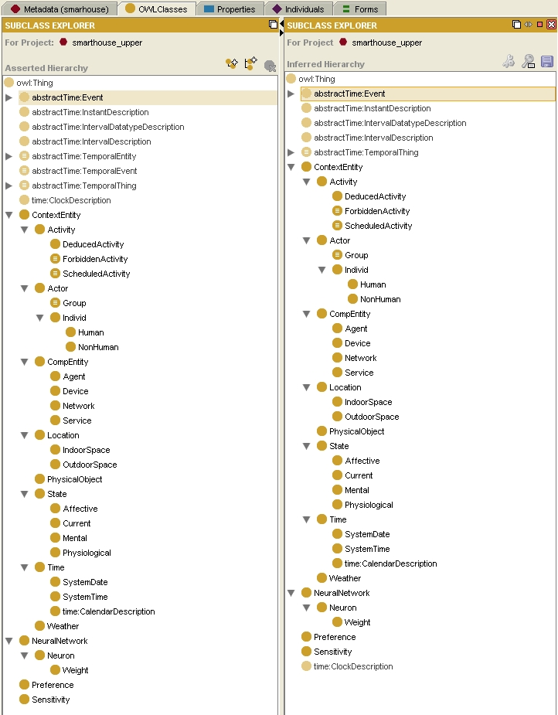
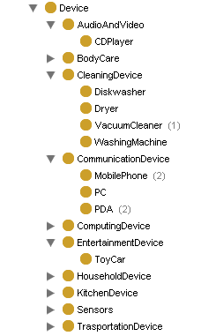
Smart House
Ontology

Slide 7
Agent technologies
Agent
Agent Types
Agent Platforms
Advantages of the agent technology

Slide 8
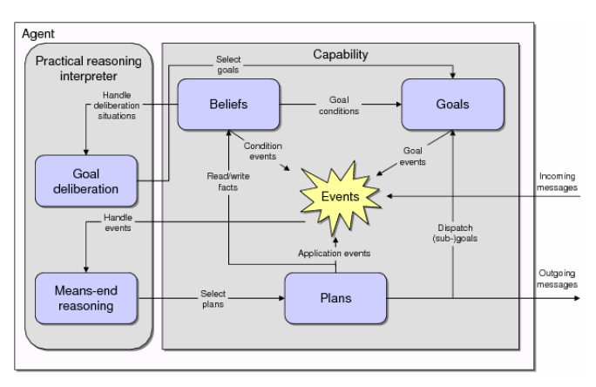
BDI Agent Model

Slide 9
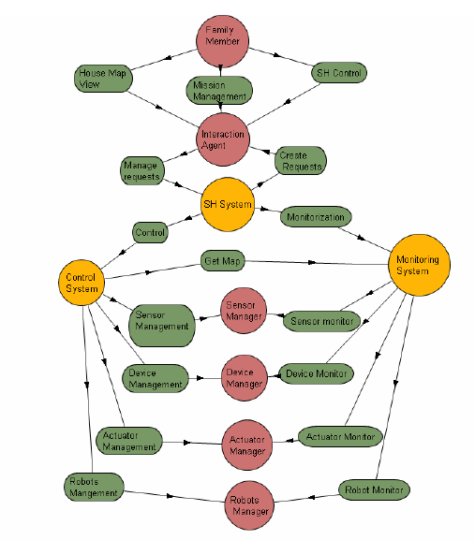
Detailed Design based on the TAOME methodology
Early Requirments Analysis
Late Requirments Analysis
Architectural Design
Detailed design
Implementation

Slide 10
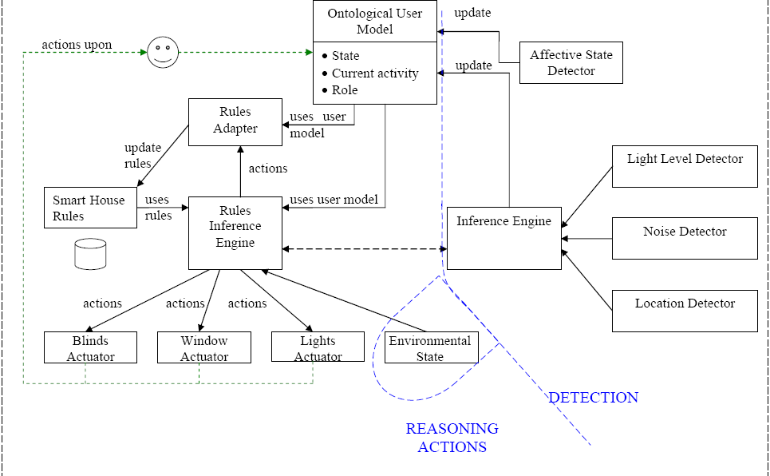
Smart House Conceptual Diagram

Slide 11
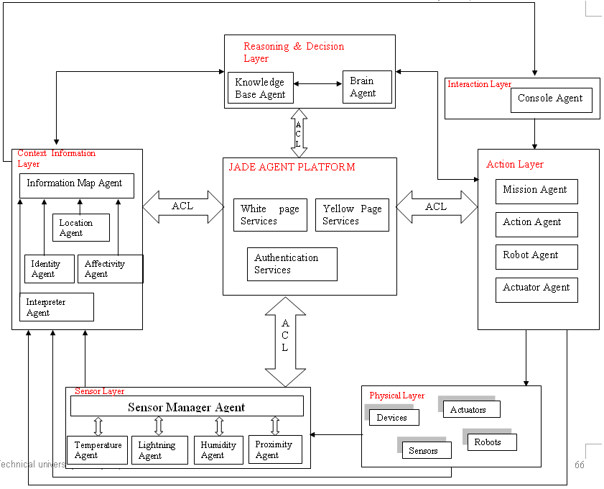
Smart House Architecture

Slide 12
Results
The analysis of the current solutions in the domain of context-aware applications (ontology models, multi-agent platforms, context-aware systems)
Ontology design and implementation using Protege
The analysis, design and implementation of the multi-agent system based on the TAOM4e methodology

Slide 13
Results
The

Slide 14
Results
The

Slide 15
Conclusions
Future Developments
Integrate a real Sensor Network, Emotional State Detector, a complete and functional version of the Expert-System.
Solve Jadex agent mobility limitations
Deployment of the system in a real environment

